Slide 1
CPE 656
Software Engineering Studio I
Train Location Project
University of Alabama in Huntsville
October 26, 2015
Stephen Jalbert
Rashad Madyun
Corey Sanders

Slide 2
WORK PRODUCTS
Status
SRS: Added Formal Use Cases, Organized Requirements into Tables, Updated References, Updated Software Interfaces section.
STP: Created Initial Version
Geometry Collection: Collected hardware, reviewed triangulation formulas
Project Management Document: Initial Version With Risks
SDP: Included risk management. Added Test Manager Role.
CM: Included Test Manager Role

Slide 3
WORK PRODUCTS
Agenda (10/26 – 11/2)
ROM, Process Document , Configuration Management Document, Test Plan
  Await Feedback
SRS
  Create more models
SDD
  Create initial draft.
Geometry Collection
  Finialize Preparing to Collect Data

Slide 4
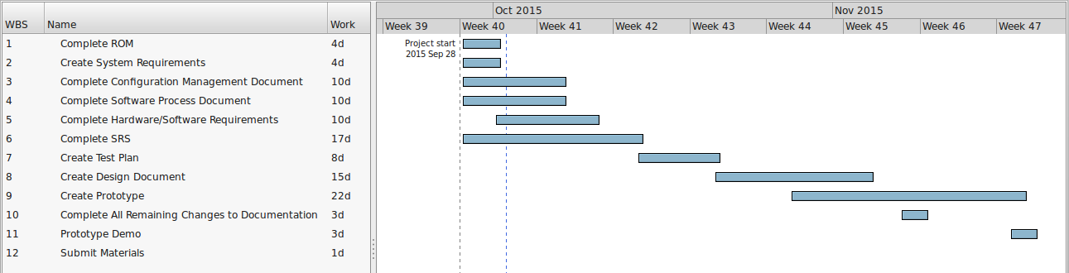
Schedule

